Slide 1
CYRIM Fake News Detector
CYBERX
Narendran S Nair
Aravind MS
Vikas Jose K
Suhaib MT

Slide 2
Introduction
We live in a world of mis- information and fake news. The goal of this hands-on project is to detect fake news based on Recurrent Neural Networks.
NLP work by converting words(text) into numbers.
These numbers are then used to train an AI/ML models to make predictions.
Al/ML-based fake news detector is crucial for companies and media to automatically predict whether circulating news is fake or not.

Slide 3
Solution Proposal
Import libraries/datasets and perform preliminary data processing
Perform Exploratory data analysis
Perform data cleaning
Visualize datasets
Prepare the data by performing tokenization and padding

Slide 4
Solution Proposal
Understand the intuition behind recurrent neural networks
Understand the intuition behind LSTMs
Train an LSTM Model
Assess/evaluate trained model performance

Slide 5
Technical Profile
Platform: Colab
Natural Language Processing
Data Science
Recurrent Neural Networks
LSTM
Python
Tensorflow
Pandas
Numpy
Plotly
Streamlit
Seaborn
Wordcloud
Nltk
Sklearn
Gensim

Slide 6
Demo Link
https://www.youtube.com/watch?v=dHDgCRXyUeY

Slide 7
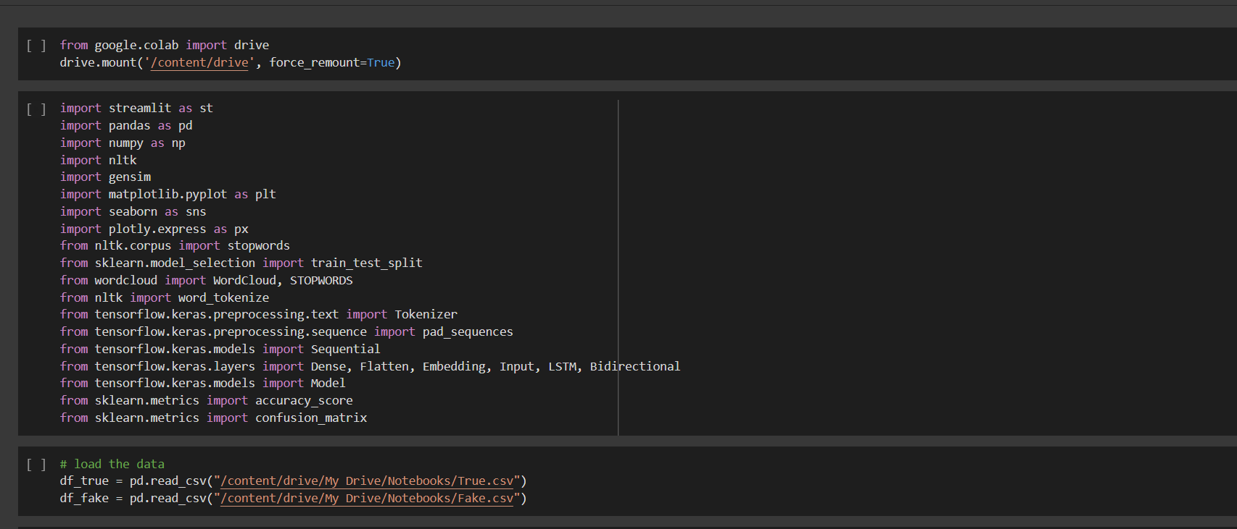
Import necessary Modules

Slide 8
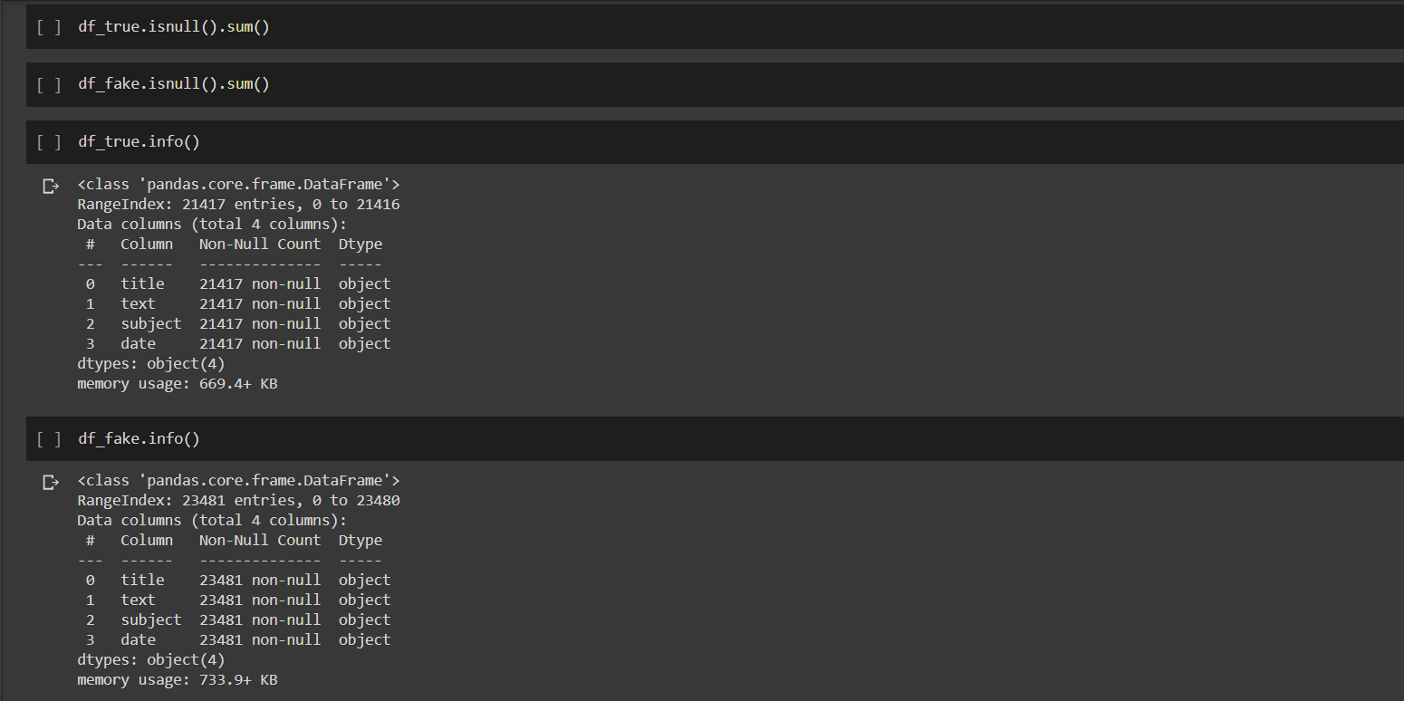
Perform Exploratory Data Analysis

Slide 9
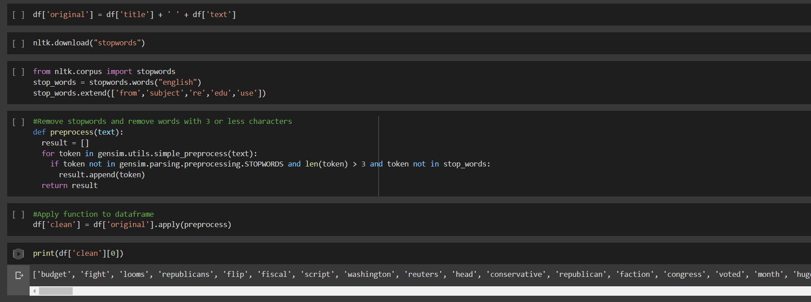
Perform Data Cleaning

Slide 10
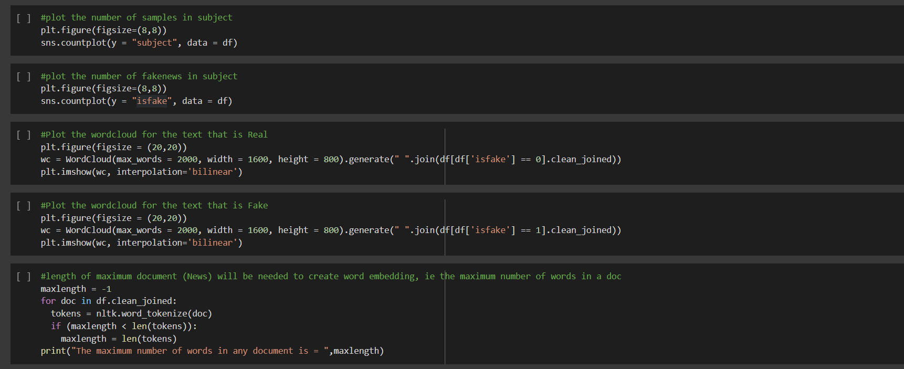
Visualize Datasets

Slide 11
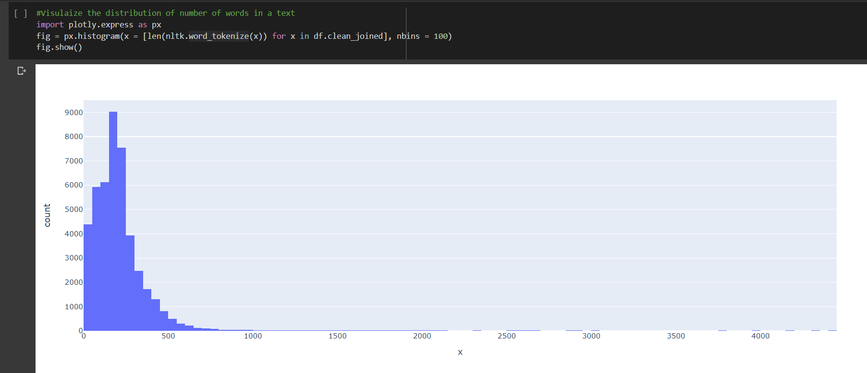
Visualize Datasets

Slide 12
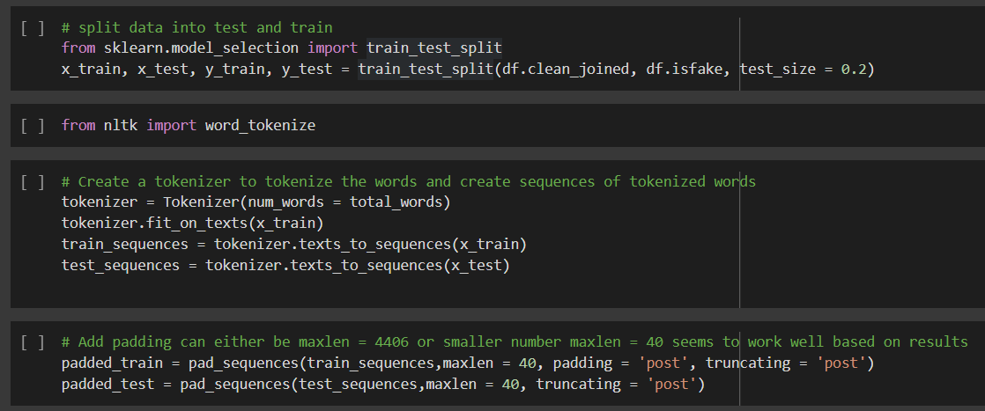
Prepare the Data by Performing Tokenization and Padding

Slide 13
Understand the intuition behind Recurrent Neural Networks
Feedforward Neural Networks (vanilla networks) map a fixed size input (such as image) to a fixed size output (classes or probabilities)
A drawback in Feedforward networks is that they do not have any time dependency or memory effect.
A RNN is a type pf ANN that is designed to take temporal dimension into consideration by having a memory (internal state) (feedback loop).

Slide 14
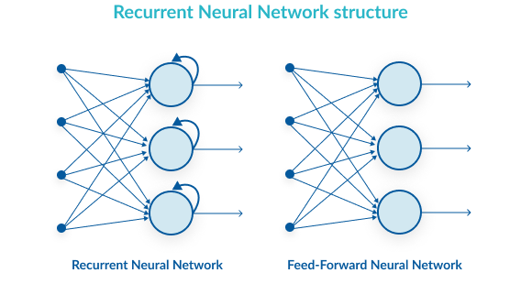
Understand the intuition behind recurrent neural networks

Slide 15
RNN ARCHITECTURE
A RNN contains a temporal loop in which the hidden layer not only gives an output but it feeds itself as well.
An extra dimension is added which is time.
RNN can recall what happened in the previous time stamp so it works great with sequence of text.

Slide 16

RNN ARCHITECTURE

Slide 17
What Make RNNs So Special?
Feedforward ANNs are so constrained with their fixed number of input and outputs.
For example, a CNN will have fixed size image (28x28) and generates a fixed output (class or probabilities).
Feedforward ANN have a fixed configuration, i.e.: same number of hidden layers and weights.

Slide 18
What Make RNNs So Special?
Recurrent Neural Networks offer huge advantage over feedforward ANN and they are much more fun!
RNN allow us to work with a sequence of vectors:
Sequence in inputs
Sequence in outputs
Sequence in both!

Slide 19
VANISHING GRADIENT PROBLEM
ANN gradients are calculated during backpropagation.
In backpropagation, we calculate the derivatives of the network by moving from the outermost layer (close to output) back to the initial layers (close to inputs)
The chain rule is used during this calculation in which the derivatives from the final layers are multiplied by the derivatives from early layers
The gradients keeps diminishing exponentially and therefore the weights and biases are no longer being updated..

Slide 20
VANISHING GRADIENT PROBLEM
The error has to propagate through all the previous layers resulting in a vanishing gradient.
As the gradient goes smaller, the network weights are no longer updated.
As more layers are added, the gradients of the loss function approaches zero, making the network hard to train.
LSTM networks work much better compared to vanilla RNN since they overcome the vanishing gradient problem.

Slide 21
LSTM INTUTION
LSTM Netoworks are type of RNN that are designed to remember long term dependencies by default.
LSTM can remember and recall information for a prolonged period of time.
LSTM networks work much better compared to vanilla RNN since they overcome the vanishing gradient problem.
LSTM contains gates that allow or block information from passing by.

Slide 22
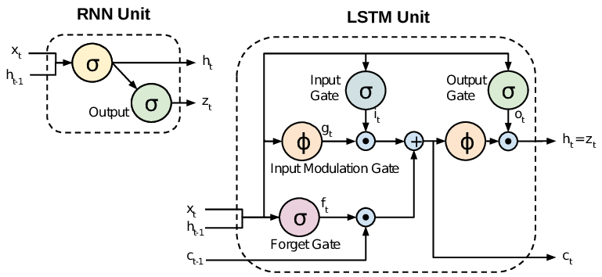
LSTM INTUTION
Sigmoid output ranges from 0 to 1.
0 = Do not allow any data to flow
1 = Allow every thing to flow

Slide 23
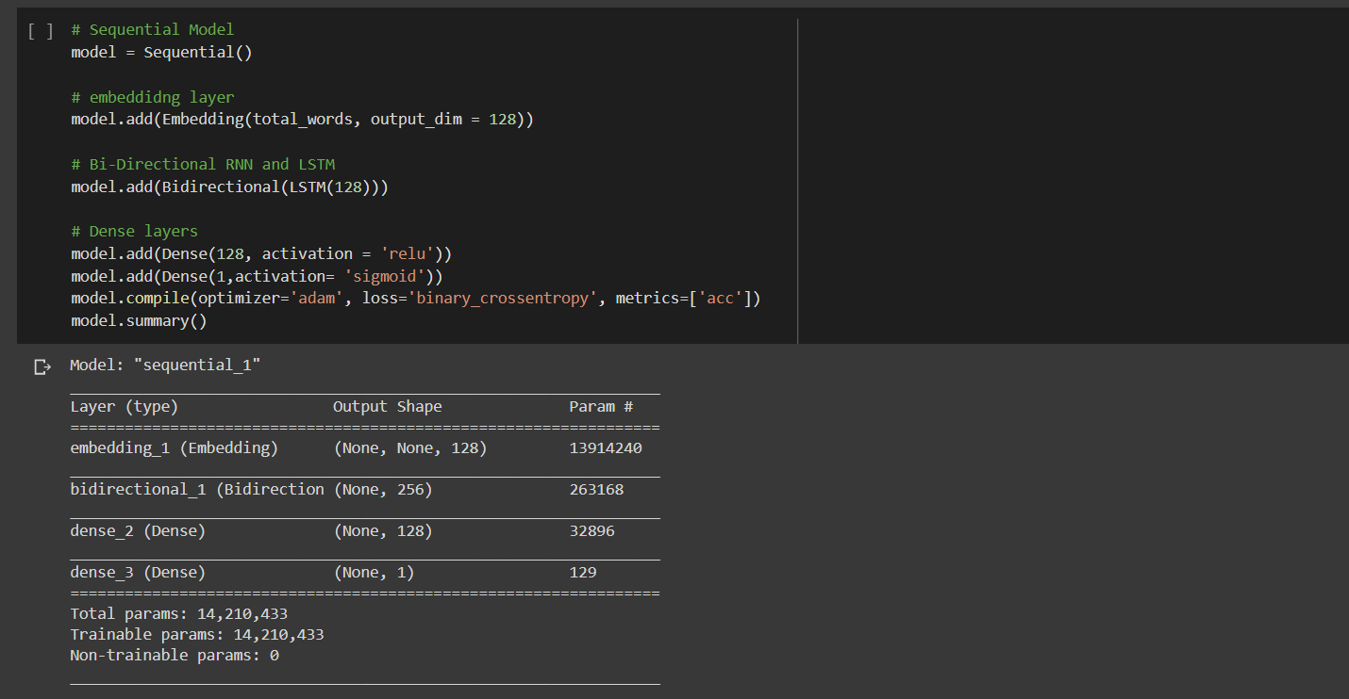
Build and Train the Model

Slide 24
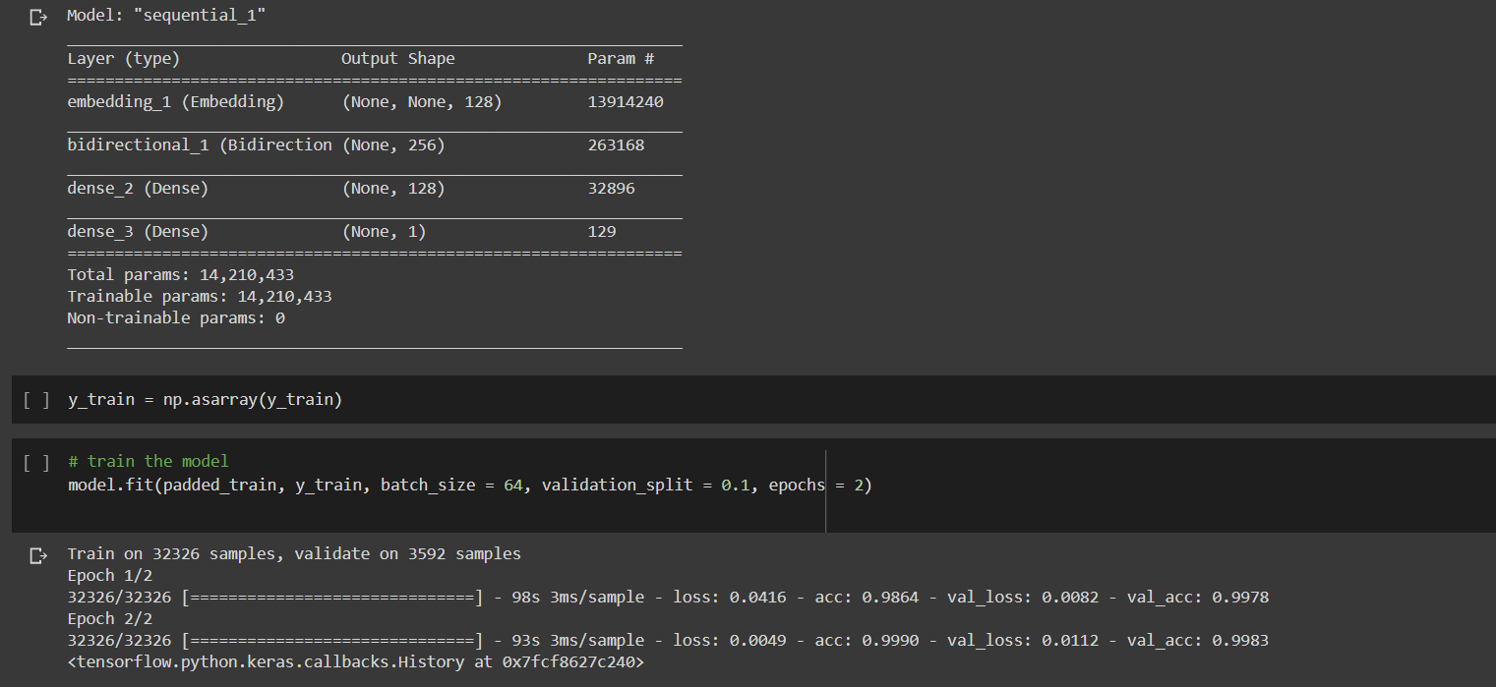
Build and Train the Model

Slide 25
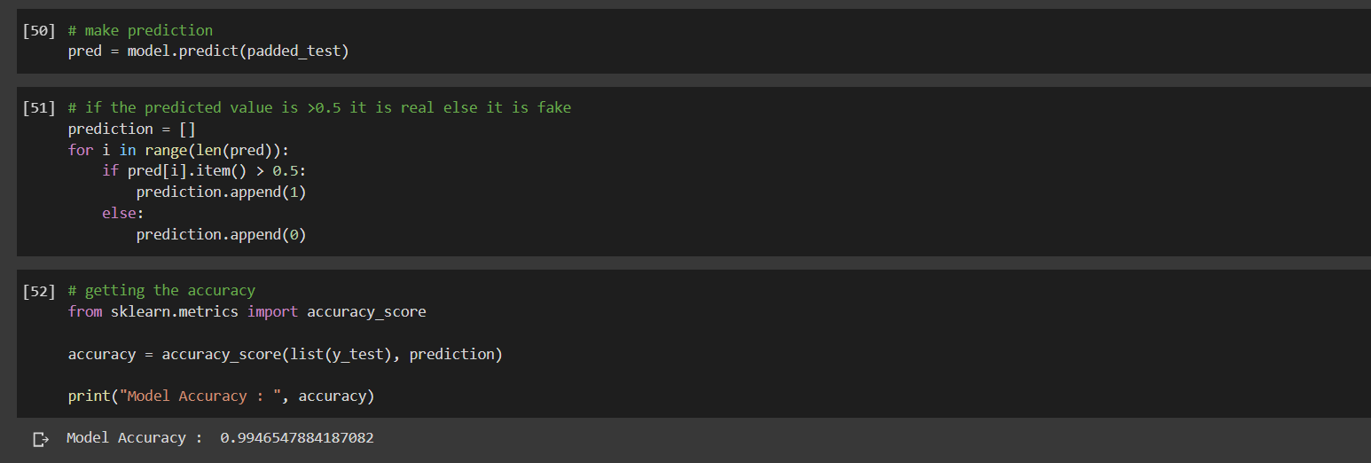
Evaluation of Model

Slide 26
Proposed Model

Slide 27
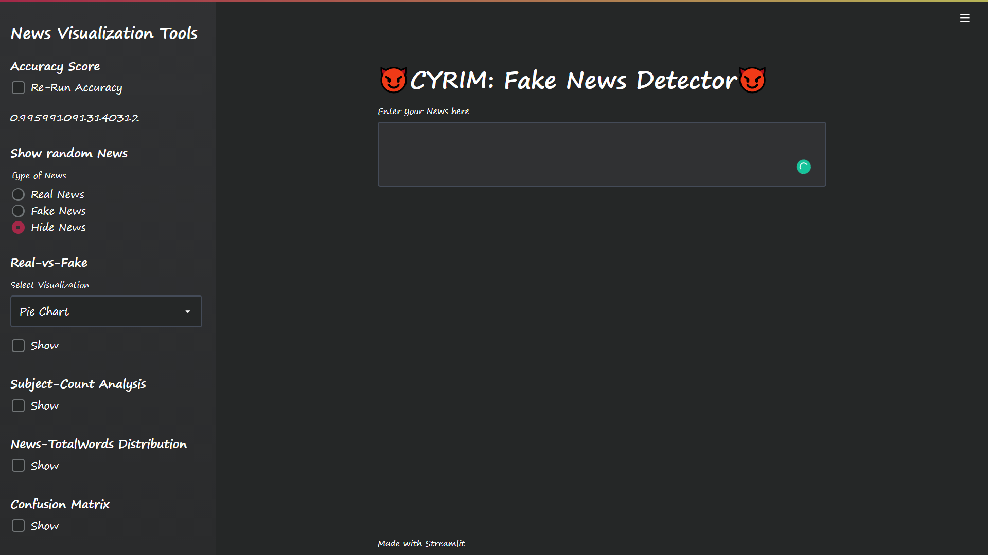

Slide 28


Slide 29
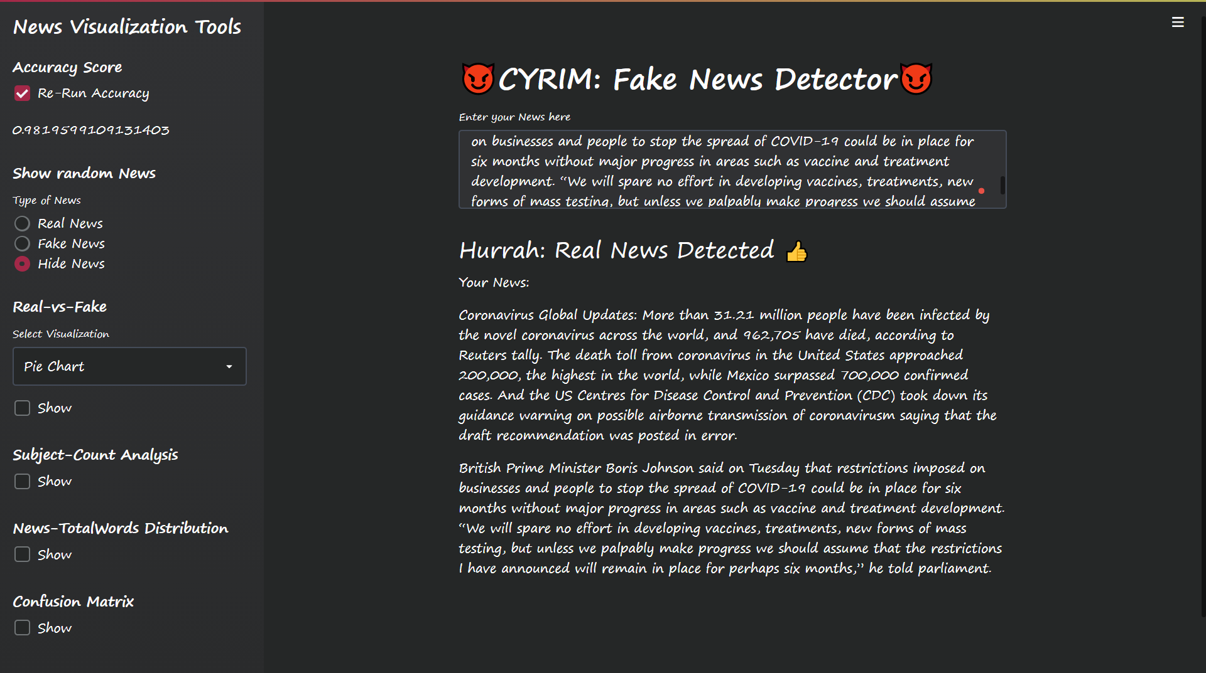

Slide 30
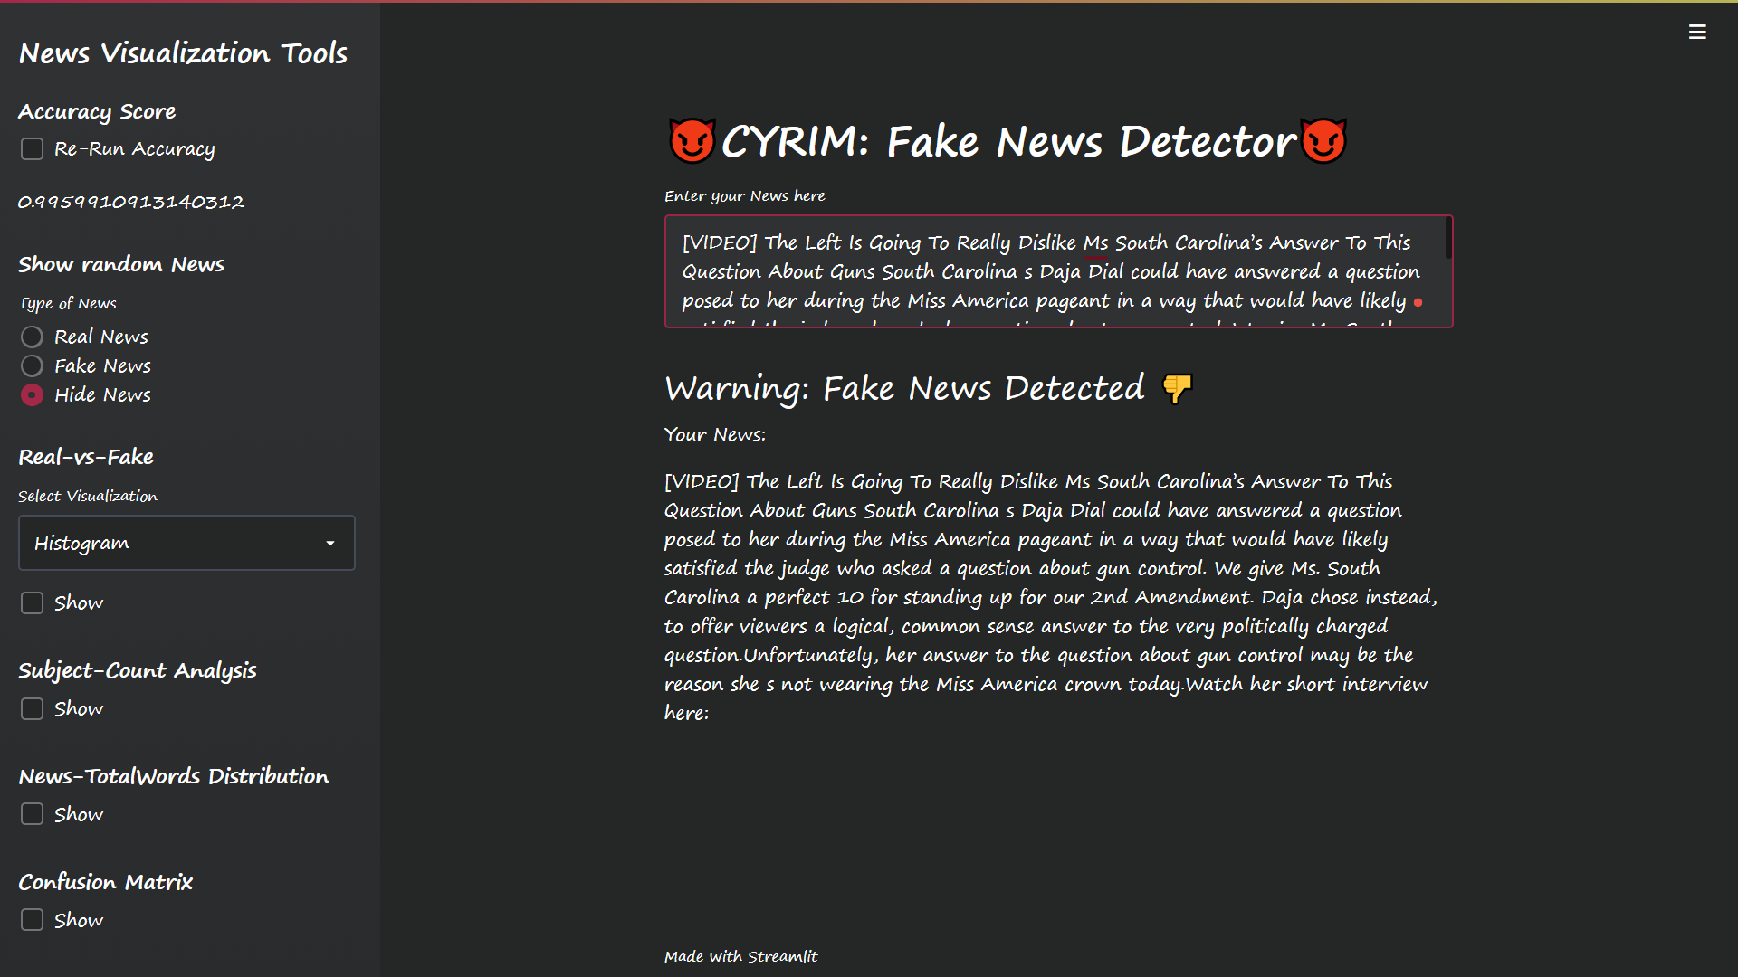

Slide 31
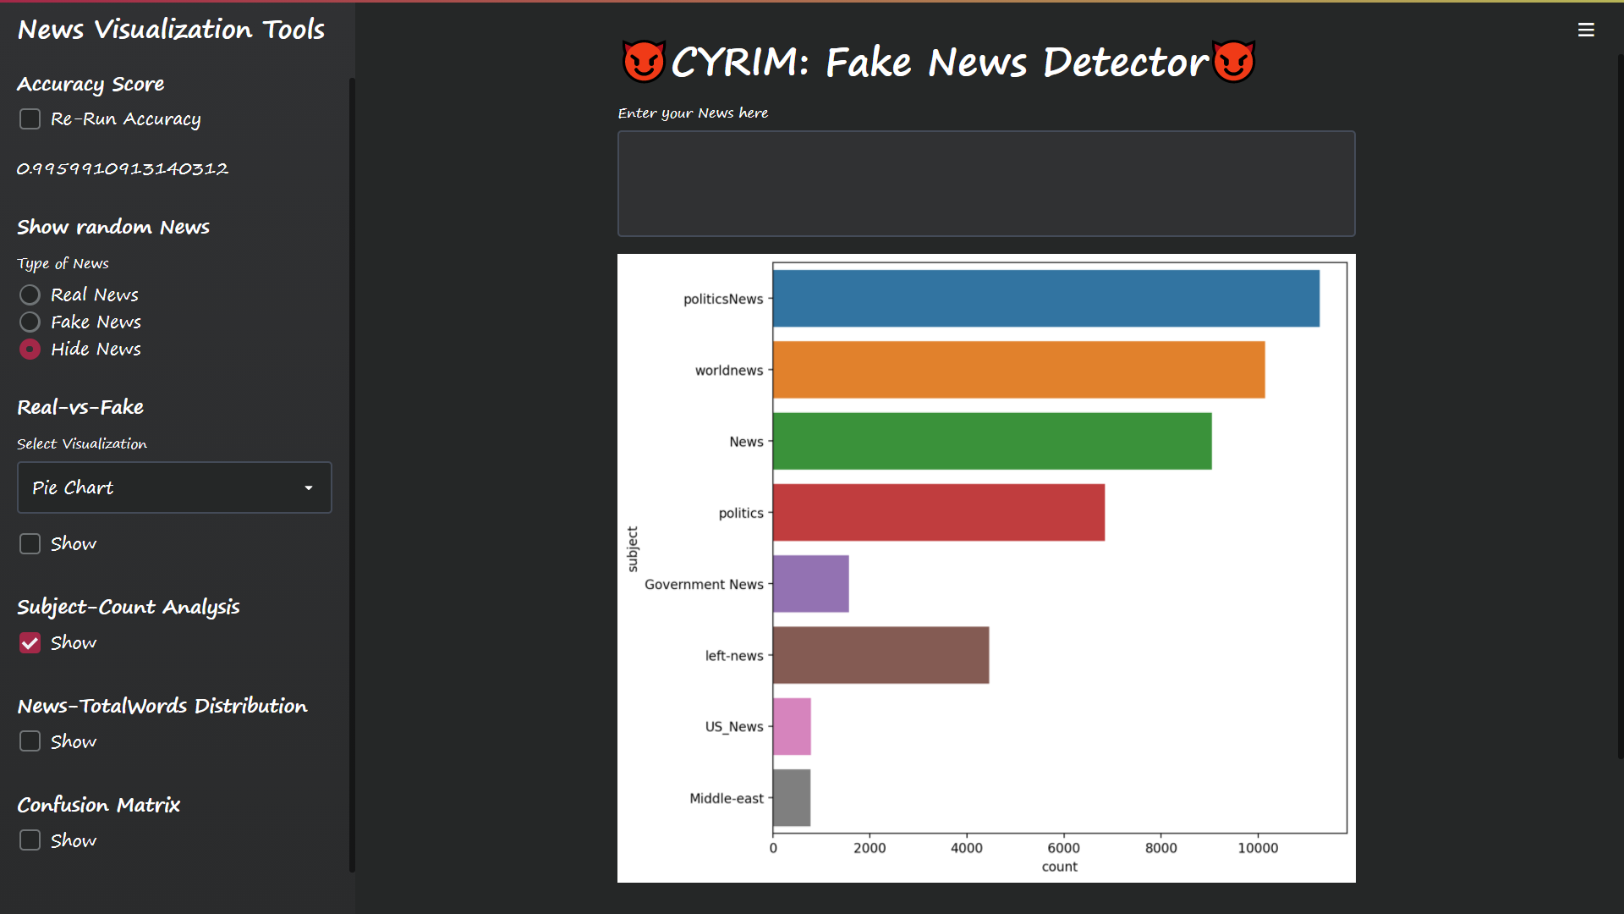

Slide 32
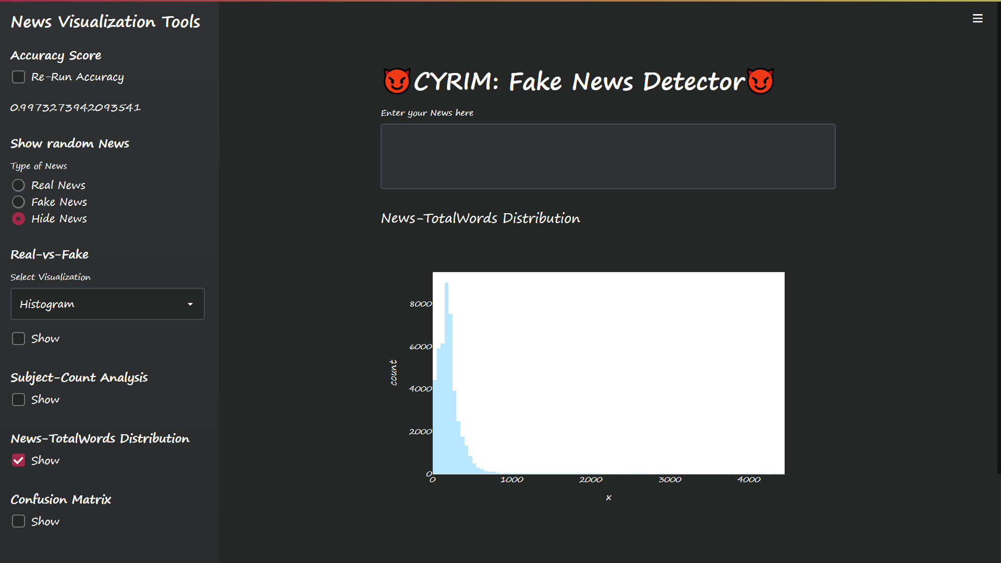

Slide 33
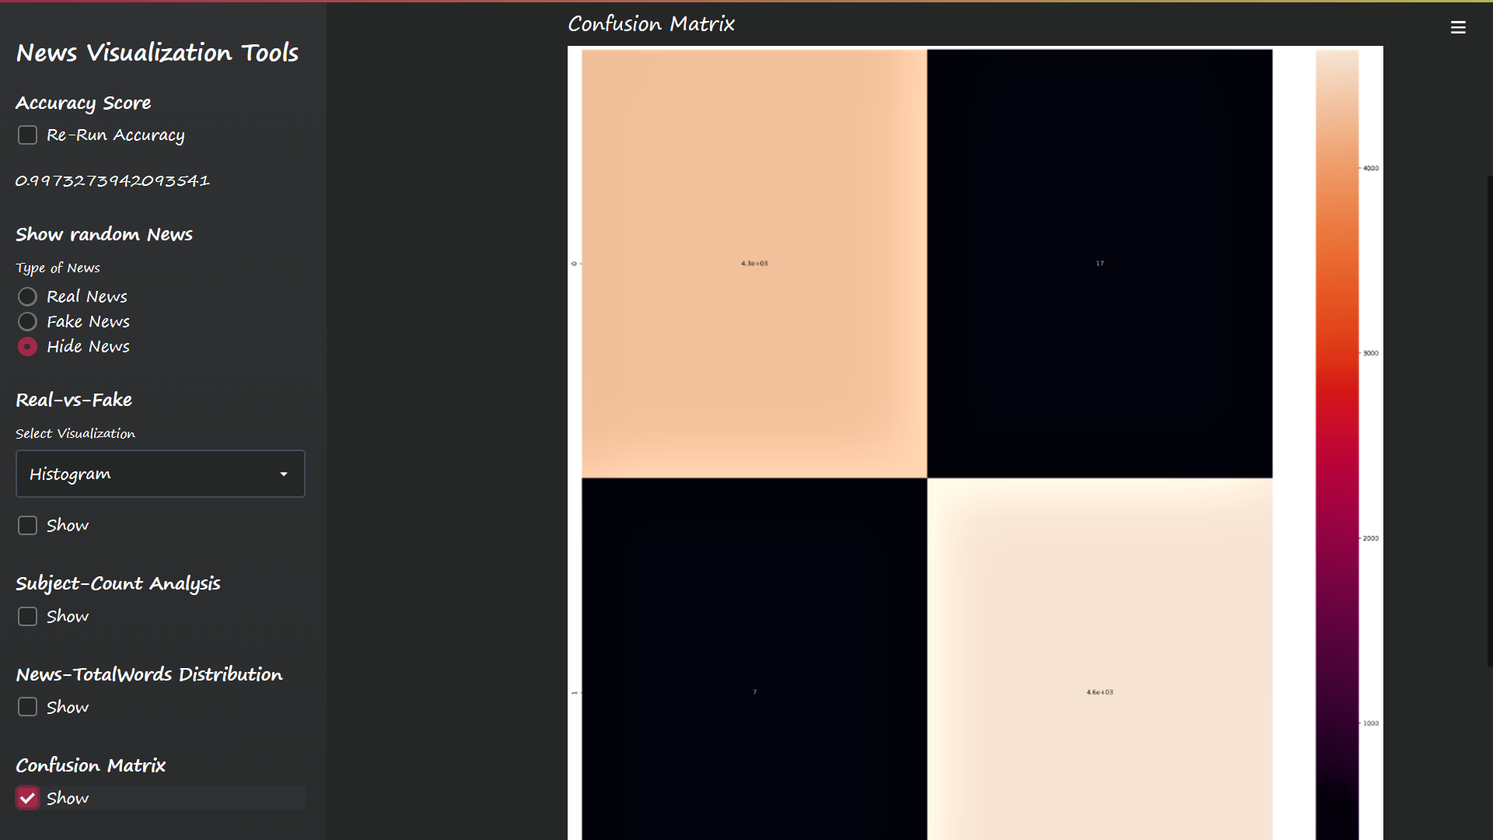

Slide 34
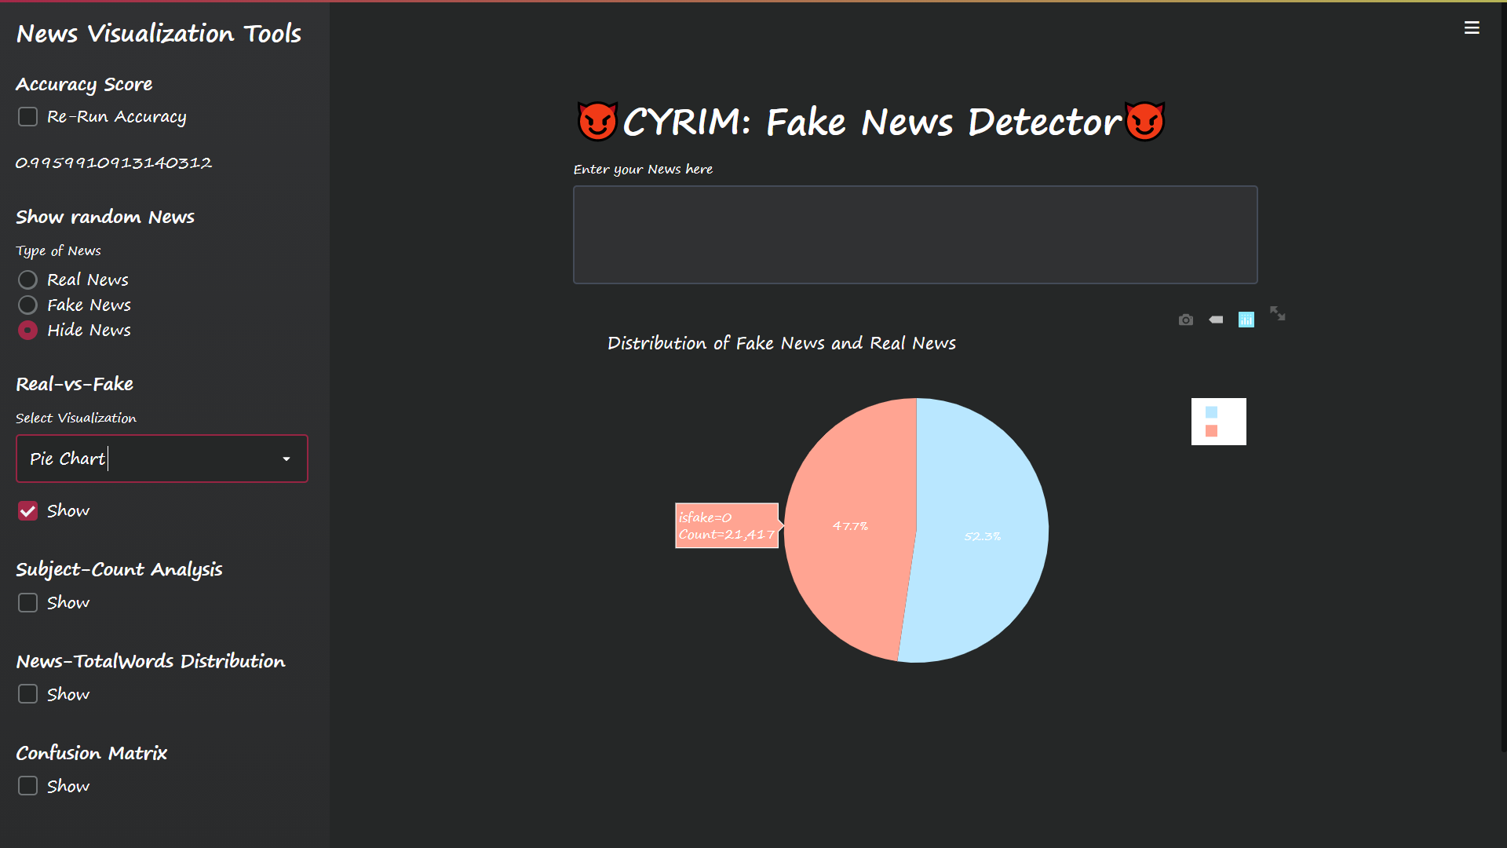

Slide 35
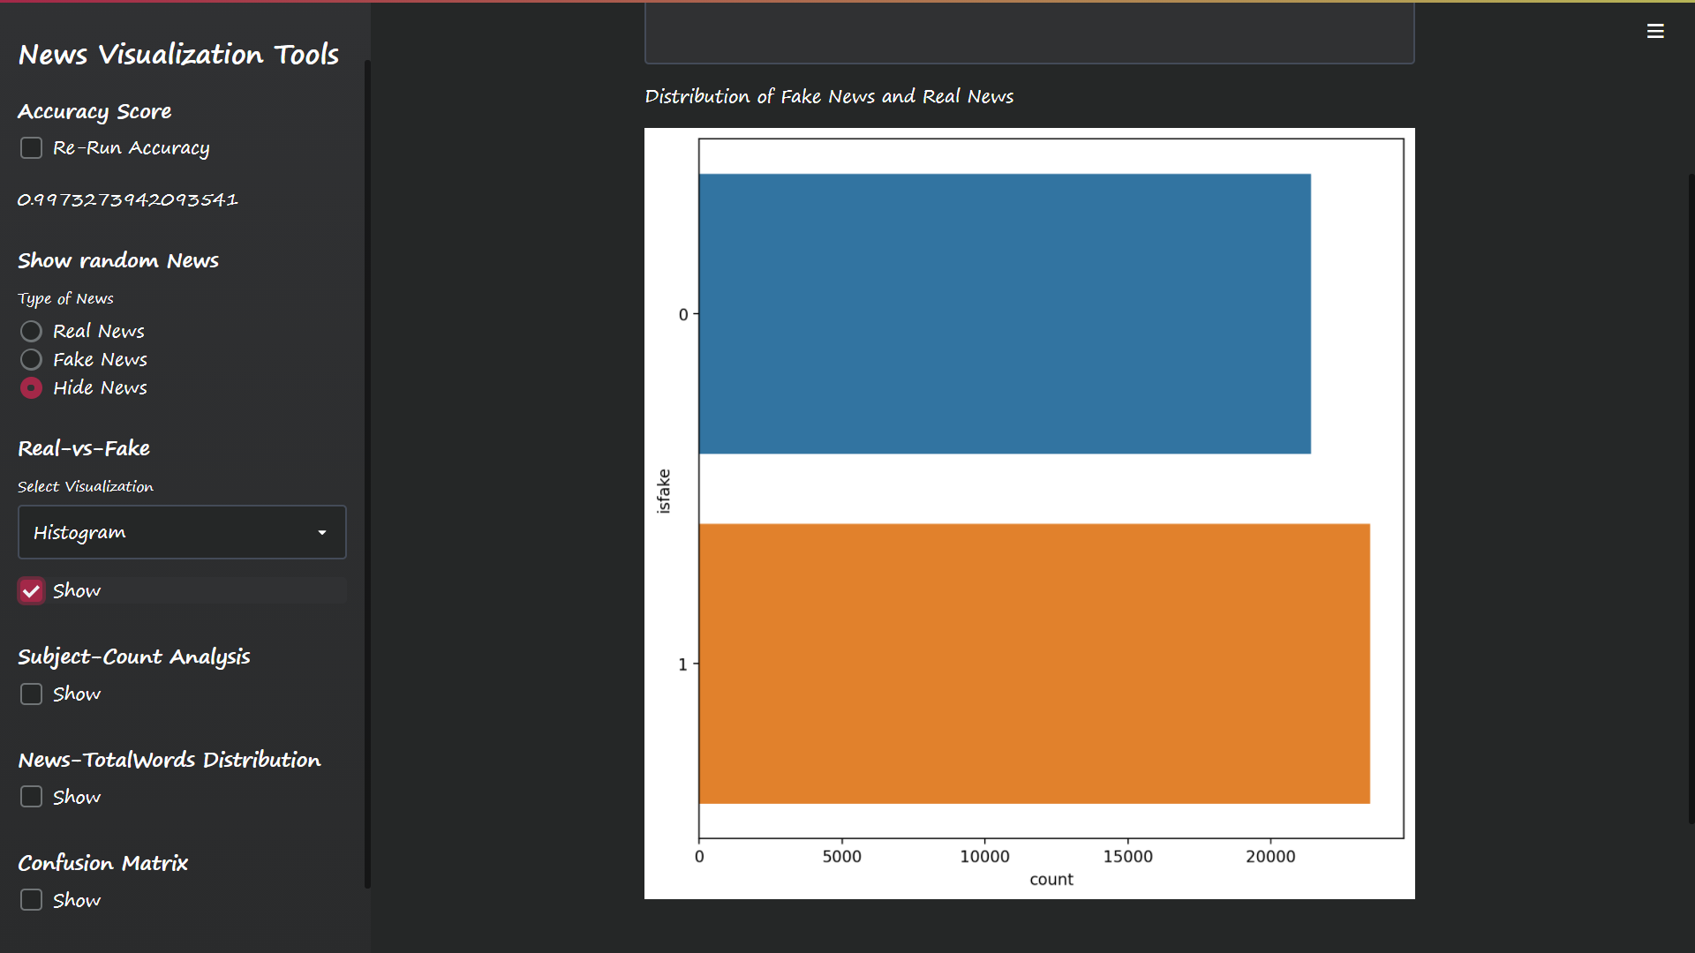

Slide 36
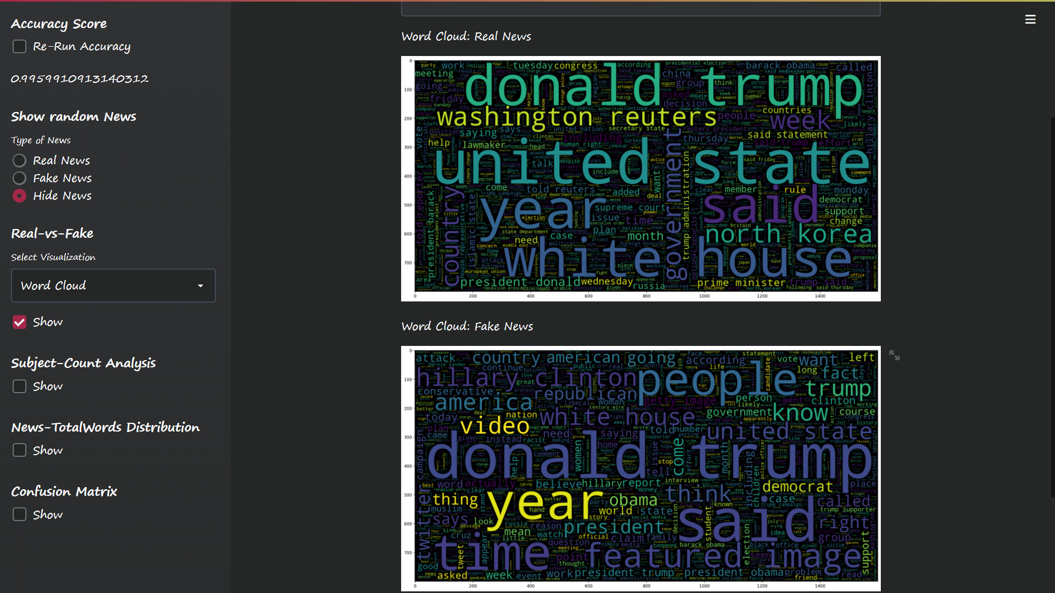

Slide 37
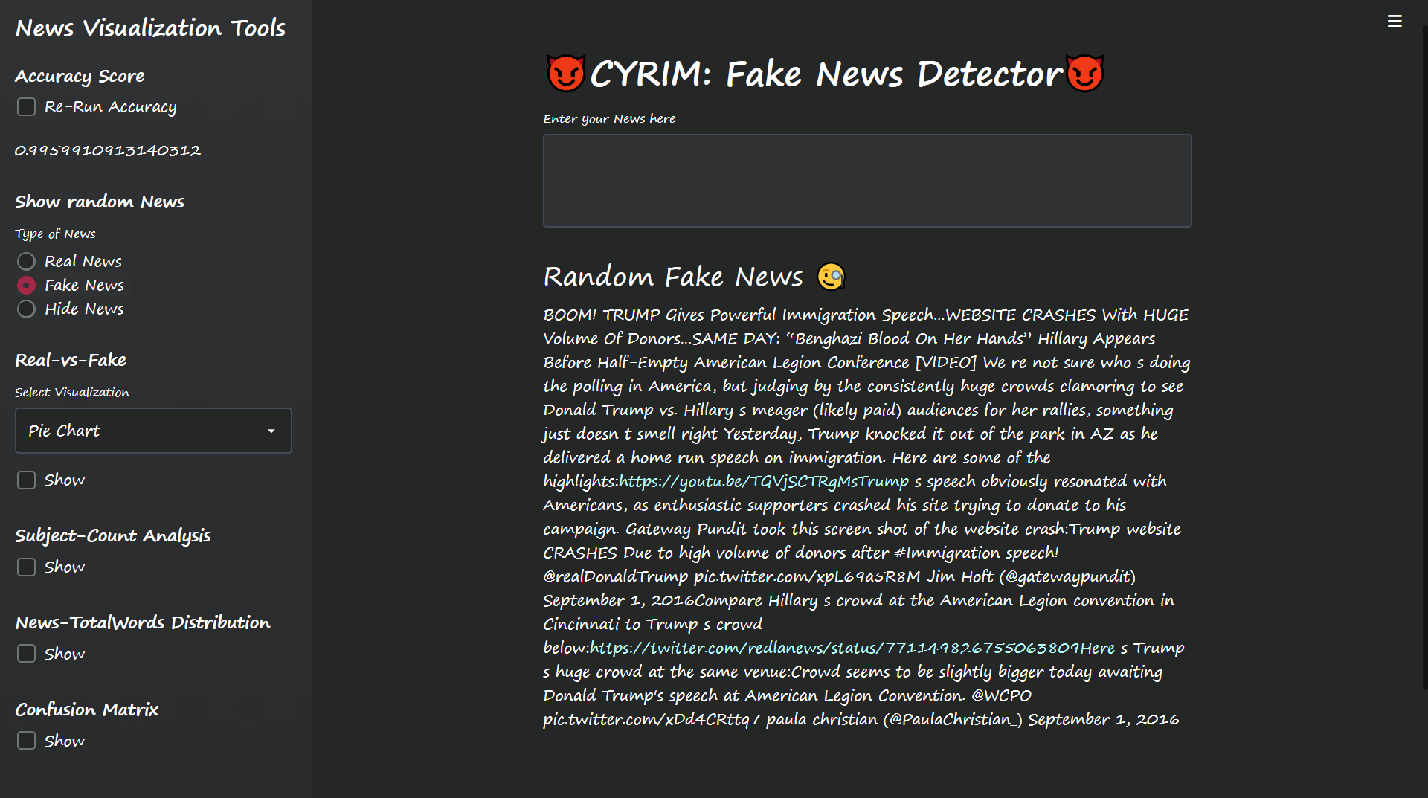

Slide 38
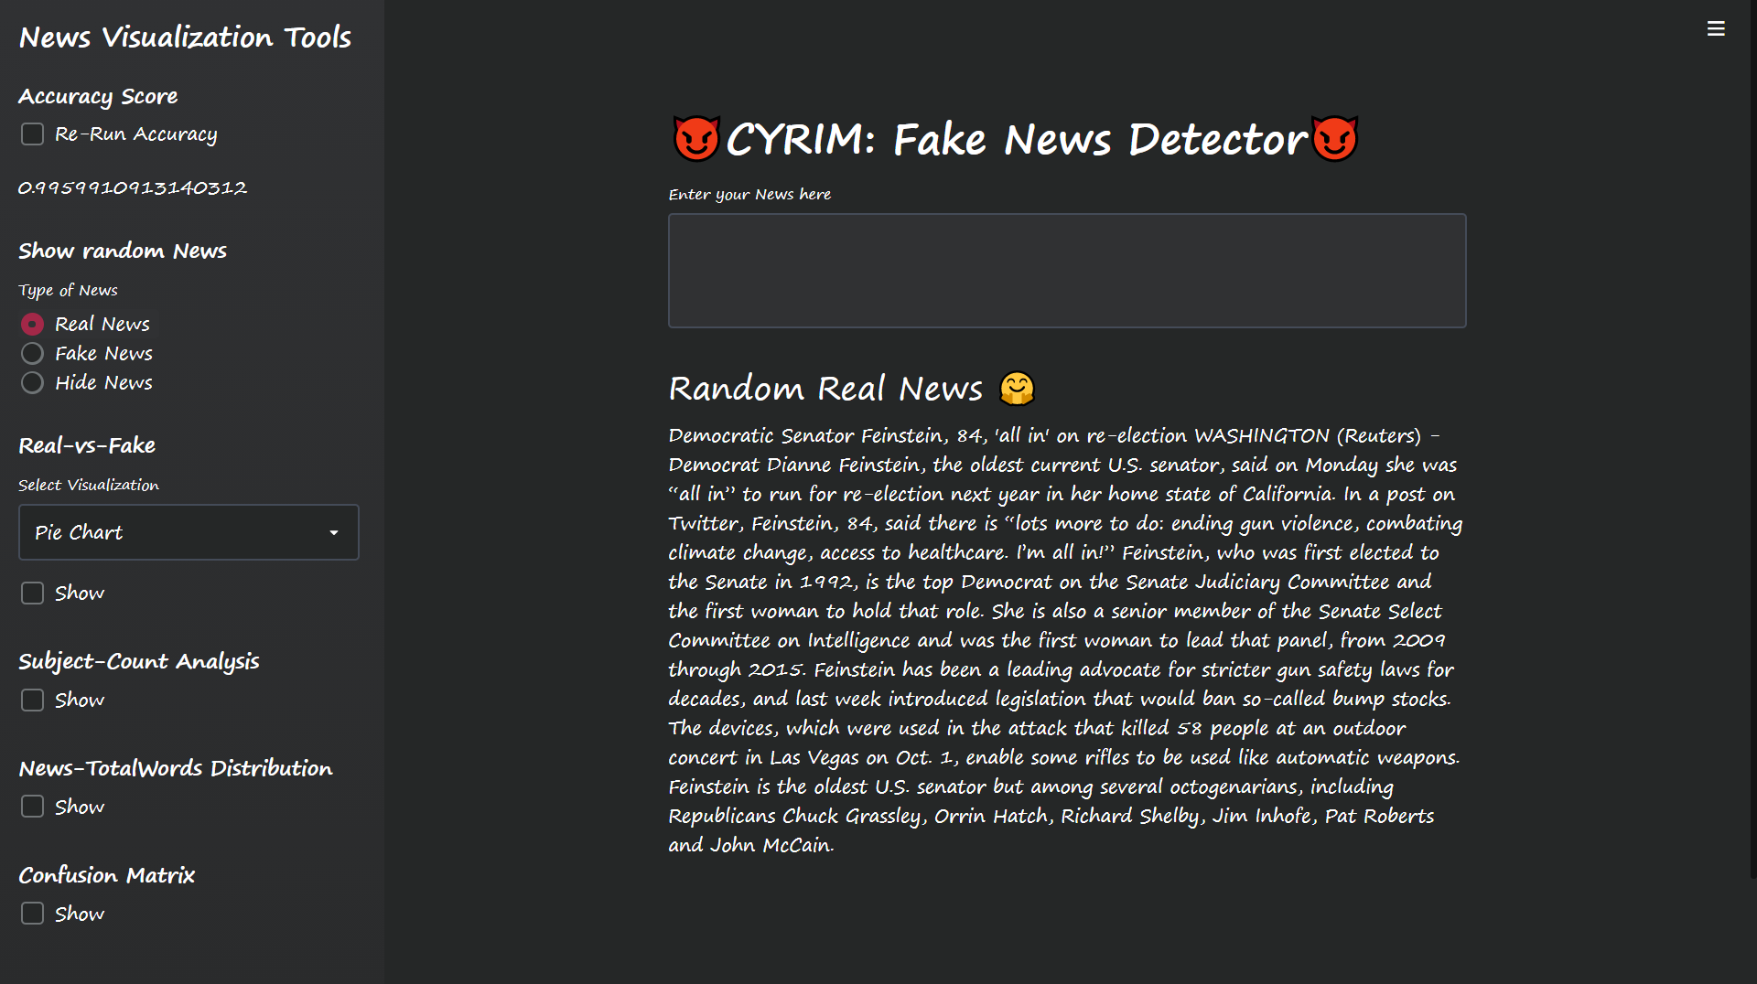

Slide 39
Thankyou
https://github.com/Narendran36/Fake_News_Detector

